Slide 1

BlogScript (Blog Web Application) Presentation
BCAMP23601
Degree: BCA
Team Members
Pankaj Kumar Das
Rahul Kumar Senuhar
Rajneesh kumar
Course: BCA (6th Sem)
Project Guide:
Mr. Ajay Singh Sir
Mr. Magan SIr
COLLEGE OF COMPUTING SCIENCE & INFORMATION TECHNOLOGY
TEERTHANKER MAHAVEER UNIVERSITY, MORADABAD

Slide 2

Team Details
Name | Enrollment | Role
RAHUL KUMAR SENUHAR | TCA2301558 | Frontend Developer
PANKAJ KUMAR DAS | TCA2301489 | Backend Developer Testing & Debugging Hosting & Deployment
RAJNEESH KUMAR | TCA2301573 | Documentation & Database Handling
2

Slide 3
Table of Contents
Project Brief Introduction
Methodologies/ Technologies/ Tools to be used
Process of Implementation
Context Diagram (Overall Project)
ER Diagrams
DD Diagrams
Challenges Encountered
Advantage of The Project
Summary and Conclusion
Appendices
3

Slide 4
1. Project Brief
BlogScript is a CRUD-based web application developed to provide blogging enthusiasts with a simple, secure, and user-friendly platform for sharing their ideas, thoughts, and knowledge. The primary goal of BlogScript is to make content creation and management easy for users who may not have advanced technical skills, while still maintaining a professional and structured system in the background.
The platform enables users to register and create personal accounts, allowing each user to manage their own blog content securely. Once logged in, users can create new blog posts, edit existing posts, update content as needed, and delete posts they no longer wish to publish. These core CRUD (Create, Read, Update, Delete) operations form the backbone of the application and ensure efficient content management.
4

Slide 5
2. Methodologies/ Technologies/ Tools to be used
Step 1: Requirement Analysis
Identified core features: user authentication, blog post management, and email verification.
Step 2: System Design
Designed the database schema with users and posts tables.
Designed responsive frontend layouts for signup, login, dashboard, and post pages.
Step 3: Backend Development
Implemented User Authentication (signup, login, password hashing).
Step 4: Frontend Development
Built responsive UI using HTML, CSS (custom + media queries), and JavaScript.
Step 5: Integration
Step 6: Testing
Step 7: Deployment & Future Scope
5

Slide 6
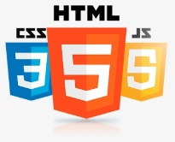





2. Methodologies/ Technologies/ Tools to be used
Technical Skills:
PHP for server-side scripting
MySQL database management
JavaScript for form validation and interactivity
HTML & CSS for responsive UI design
Git for version control and Infinity free Hosting
Professional Skills:
Working in a tech environment
Time management while handling project deadlines
Problem-solving and debugging techniques
Communicating effectively with supervisors and peers
6

Slide 7
3. Process of Implementation
Step 1: Setting Up development Environment
Step 2: Developing dynamic web pages in PHP to enable basic CRUD (Create, Read, Update, Delete) application.
Step 3: Advanced Features Implementation
Step 4: Security Enhancements
Step 5: Testing the application for bugs, debugging code, and ensuring performance optimization.
Step 6 : Hosting in infinity free hosting
7

Slide 8
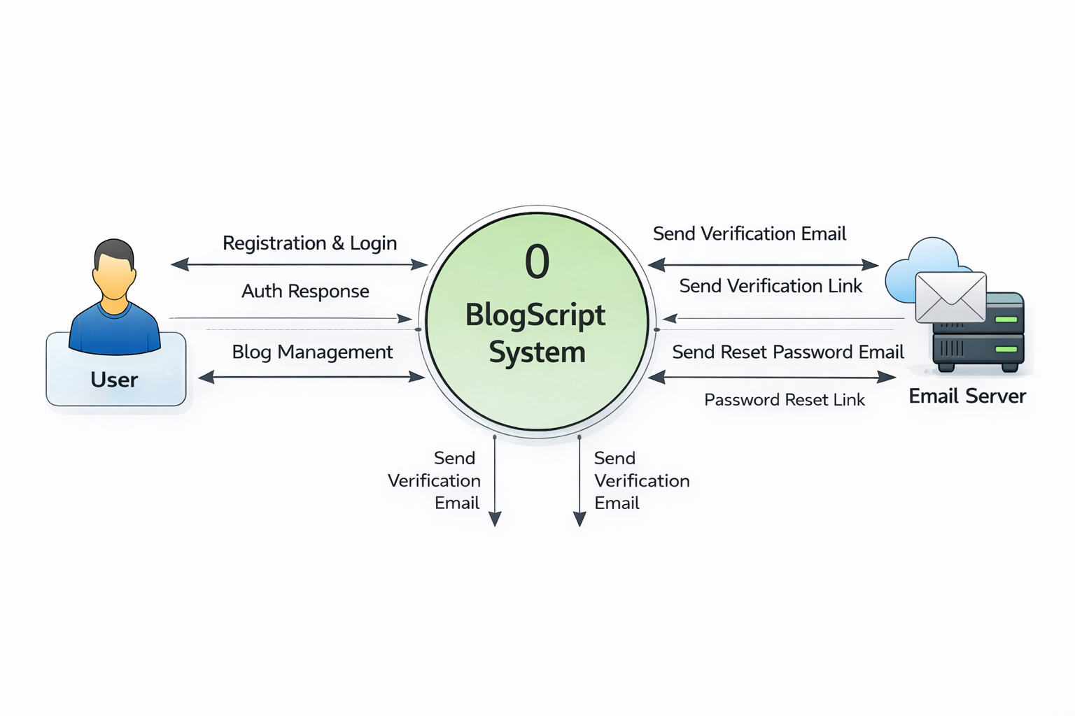
rear
4. Context Diagram (Overall Project)
A Context Diagram is a high-level visual representation that shows a system as a single process and illustrates how it interacts with external entities through data flows.
8

Slide 9
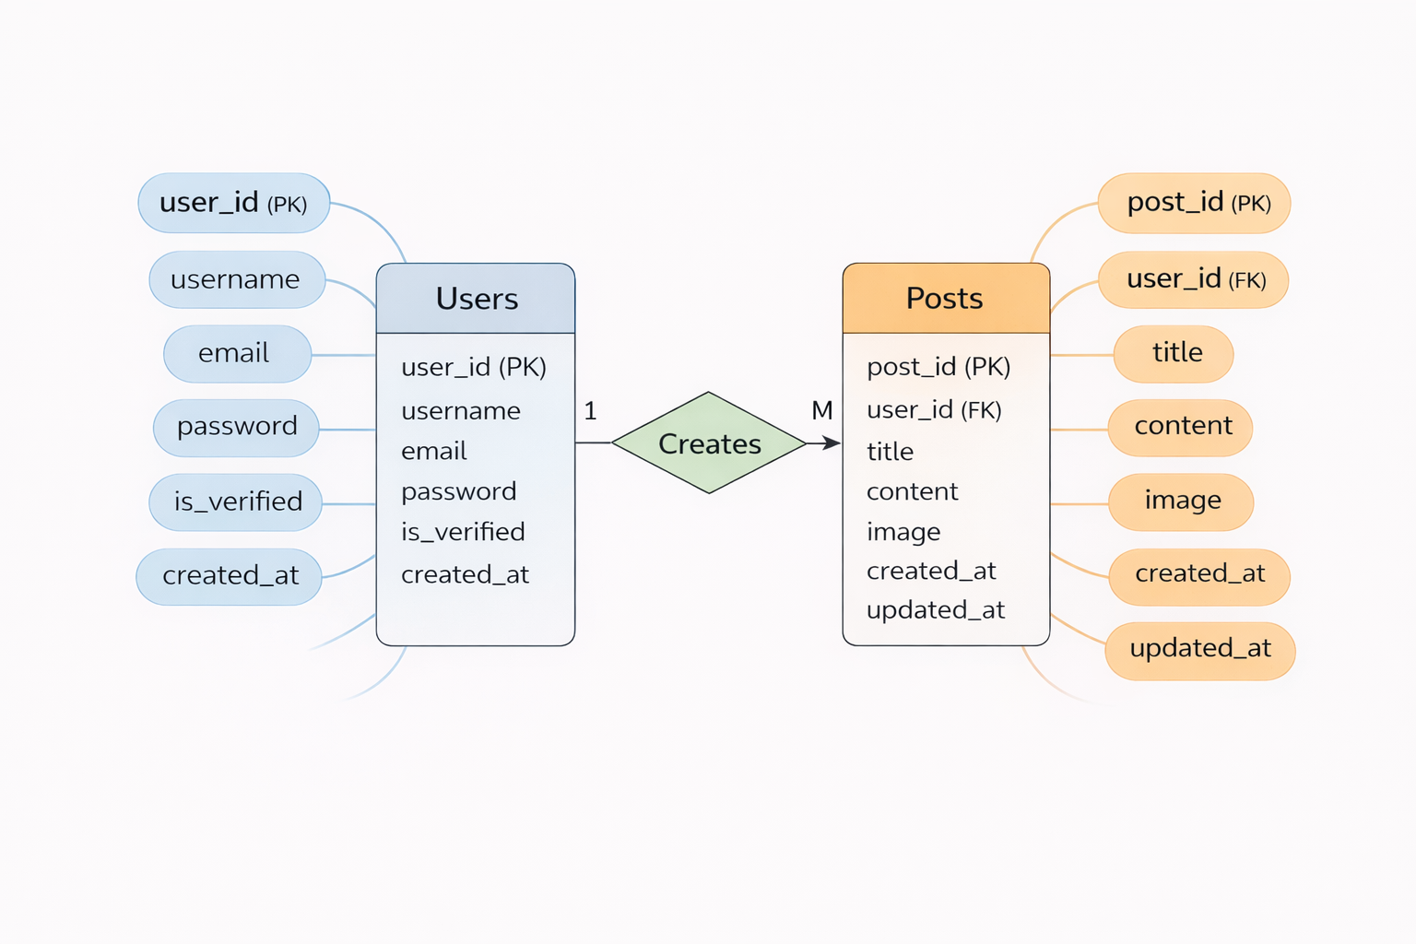
rear
5. ER Diagrams
An ER Diagram (Entity-Relationship Diagram) is a visual representation of database structure that shows entities, their attributes, and the relationships between them.
9

Slide 10
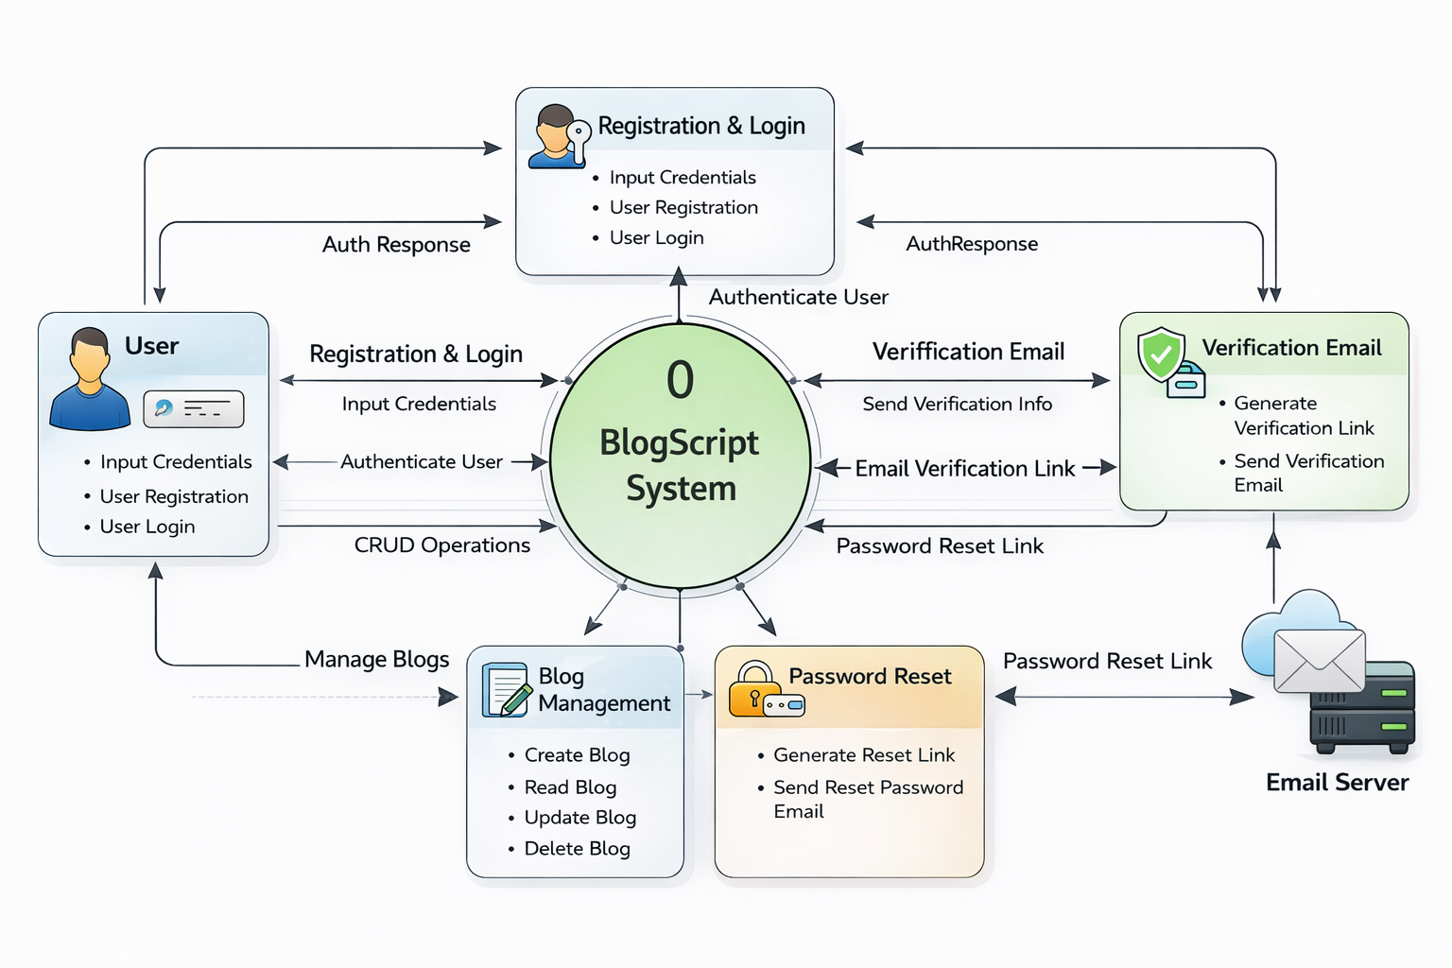
rear
6. DD Diagrams
A DD Diagram (Data Flow Diagram – DFD) is a graphical representation that shows how data moves through a system, including inputs, processes, data storage, and outputs.
10

Slide 11
7.Challenges Encountered:
Challenges | Solution
Handling complex database relationships | Learned normalization techniques and optimized queries for performance
Debugging authentication issues | Referred to PHP session handling concepts and used step-by-step debugging
Adapting to company’s coding standards | Studied their coding guidelines and followed structured documentation practices
Managing time between tasks and deadlines | Prepared daily task lists and followed Agile-based work tracking
11

Slide 12
8. Advantage of The Project
Simple and User-Friendly Interface
The platform is designed with simplicity in mind, allowing users to navigate easily without any technical difficulty. The clean layout ensures that users can focus on writing and managing their blogs rather than learning complex features. This makes the application suitable for beginners
Secure Authentication System
BlogScript provides a secure login and signup system using password hashing techniques, which protects user credentials from unauthorized access. The password reset feature further enhances security by allowing users to safely recover their accounts without compromising data integrity.
Email Verification for Account Authenticity
The inclusion of email verification ensures that only genuine users can create accounts. This helps prevent fake registrations, reduces spam, and increases the overall trustworthiness of the platform.
Complete Blog Management with CRUD Operations
Responsive Design
12

Slide 13
9. Summary and Conclusion
BlogScript is a lightweight and efficient web application built on the CRUD (Create, Read, Update, Delete) model, giving users full control over their blogs. With a simple and responsive interface, it allows writers to:
Create new blog posts with ease
Read and explore articles through clean navigation
Update existing content anytime
Delete posts when no longer needed
Designed with scalability and SEO in mind, BlogScript is ideal for students, developers, and content creators who want a hands-on blogging experience while learning core web development concepts.
13

Slide 14
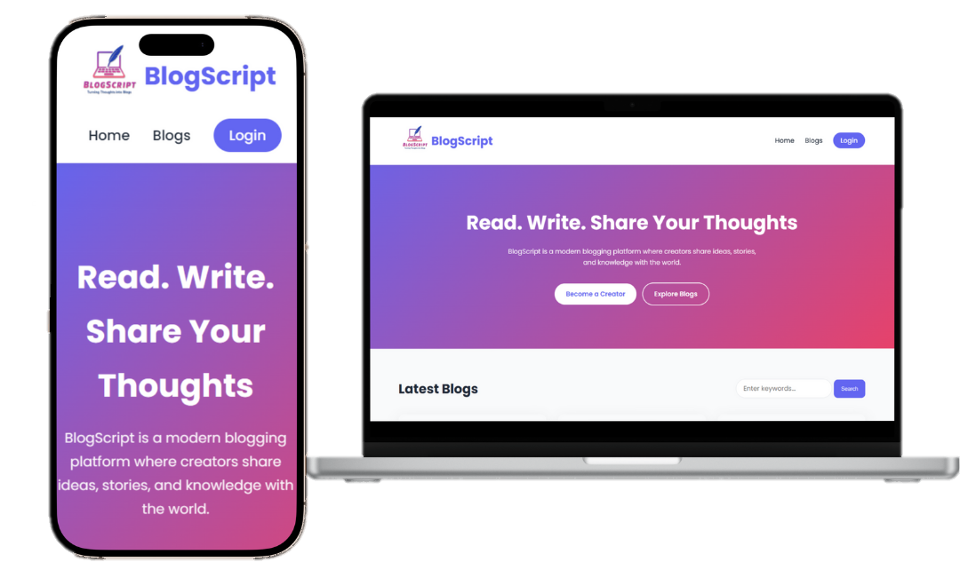
\
10. Appendices
a) User interface (Home Page)
14

Slide 15
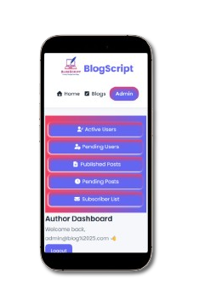
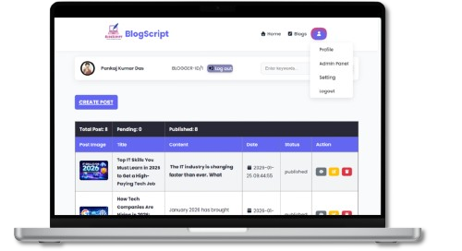
\
10. Appendices
b) User interface (Dashboard Page)
c) User interface (user admin)
15

Slide 16
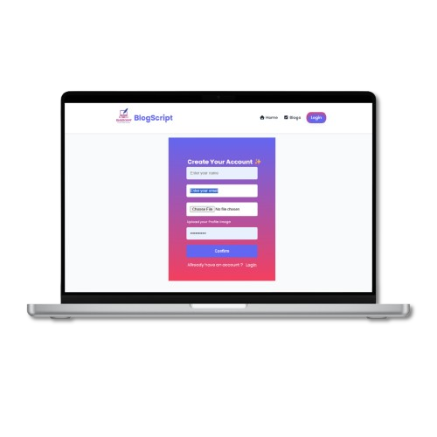
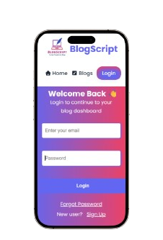
\
10. Appendices
d) User interface(Login Page)
e) User interface(Signup Page)
16

Slide 17
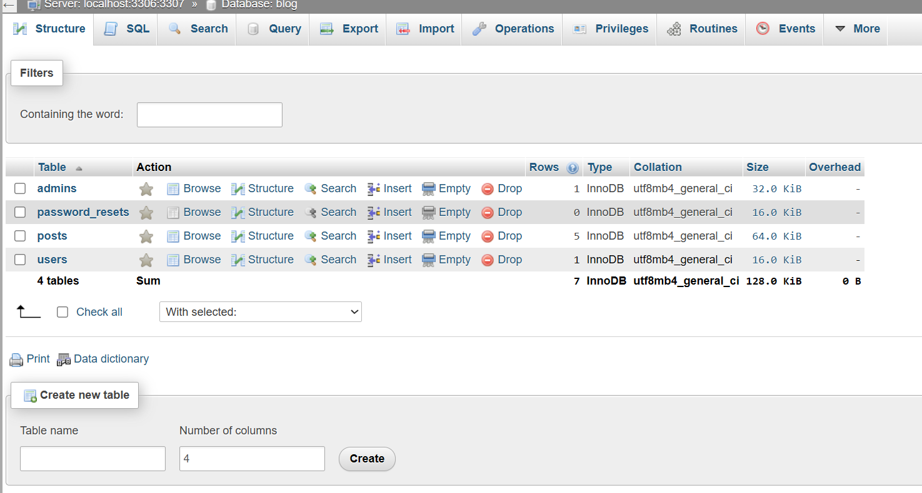
\
10. Appendices
f) Database overview
17

Slide 18
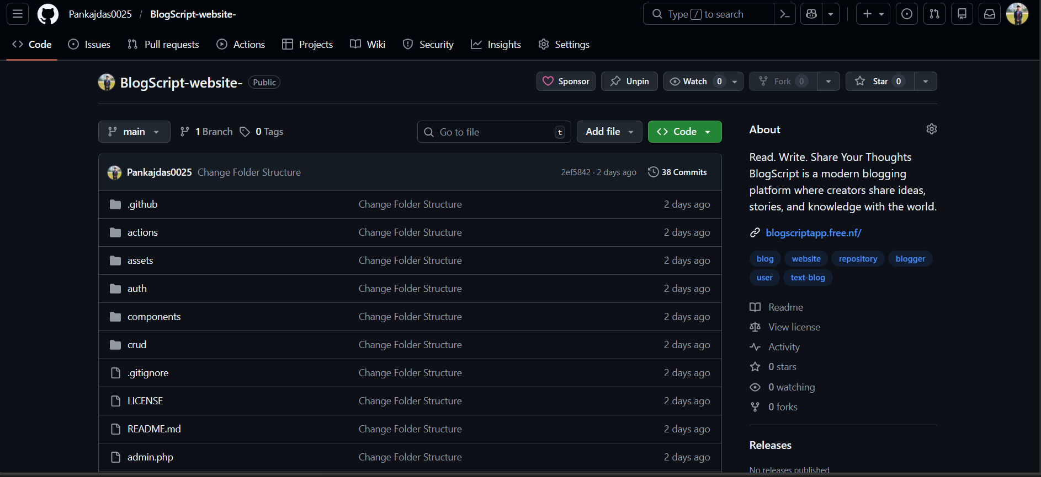
\
10. Appendices
g) GitHub Repository
18

Slide 19
\
Thank You
19

